Slide 1
Coursera Capstone Project
The Battle of Neighborhoods
Kenny Bai
June 2020

Slide 2
Report
Content
01
Introduction
The business problems that need to be solved and the background of the problems
02
Data
Describe data requirements and sources needed to solve the problems
03
Methodology and Finding
Describe data science method we are using to solve the problems and statistical testing and machine learning technics that the report performed
04
Result
Discuss the result of the analysis and proposed recommendation

Slide 3
Introduction Section
Background
I am a finance analyst currently living and working in Australia. I live in Sydney with easy access to gym and wide range of restaurants. Recently, I’ve got an offer to be a CFO in one of the world largest FMCG companies, but the company require me to work and move to New York City and I would like to explore if I can find a place to live similar with one I live now. I have a passion in fitness and Japanese food; thus, a gym and a nice Japanese restaurant are something cannot to miss in my life. My life motto is “Eat More, Exercise More”.
New York City, often called New York, has condensed population that it is easy to meet people professionally and personally. Museums, restaurants, bars and live entertainment offer great options for people love convenience. Living in the city affords one the opportunity to live a life time in a day. From a morning run in Central Park or gym, to some of the best food imaginable in the afternoon, to an evening watching comedy show in a club. Lives in New York really can be like the movies.

Slide 4
Introduction Section
Problem to be solved
How to find an ideal neighborhood in New York City that meet the following conditions:
The Borough it belongs to has good safety level
Nearby location has different good rating gym facilities
Nearby location has different good rating Japanese restaurants
List and visualize all the major parts of New York has good Japanese restaurant

Slide 5
Data Section
1. New York City Borough and Neighborhood information
3. Crime rate data indicate safety of each Borough
START
2. Restaurants detailed information and gym in NYC
Location of the future office
Data Sources: https://cocl.us/new_york_dataset
This data set has a total of 5 boroughs and 306 neighborhoods as well as the the latitude and longitude coordinates of each neighborhood..
Data Source: https://data.cityofnewyork.us/api/views/833y-fsy8/rows.csv?accessType=DOWNLOAD
This data set shows list of every shooting incident that occurred in NYC going back to 2006 through the end of 2019, indicating the safety of NYC by Borough level..
Data Source: Google Map
1540 Broadway, New York, NY 10036, United States.
Data Sources: Foursquare API
With API function in Foursquare app, we are able to locate gym and diverse restaurants and even the rating of them. .

Slide 6
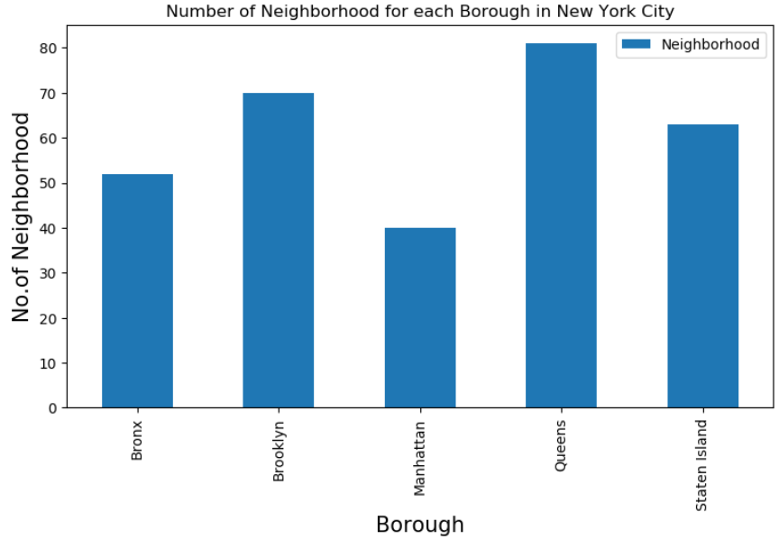
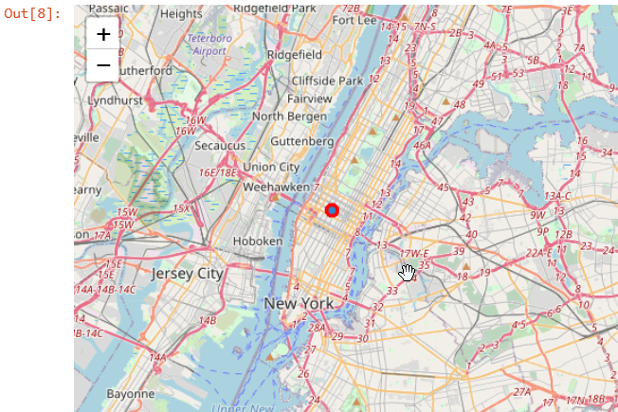
Methodology and Finding
General information of NYC
Office Location
Chart Title
35%
Contents Here
35%
Add Text Here
Add Text Here
Add Text Here
Add Text Here
Add Text Here
Add Text Here
Add Text Here
Add Text Here
Add Text Here
Add Text Here
Add Text Here
Add Text Here

Slide 7
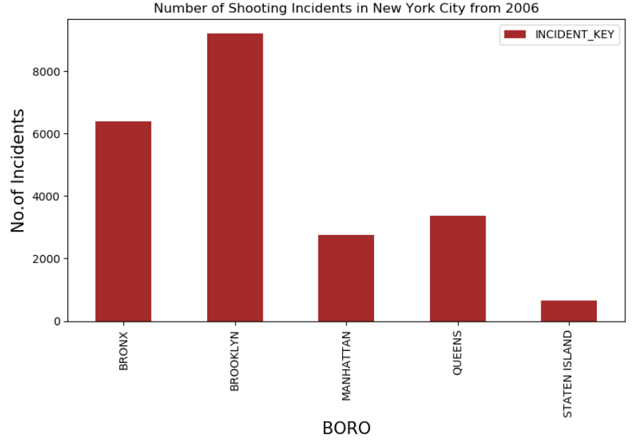
Methodology and Finding
Safety Level indication
Chart Title
35%
Contents Here
35%
Add Text Here
Add Text Here
Add Text Here
Add Text Here
Add Text Here
Add Text Here
Add Text Here
Add Text Here
Add Text Here
Add Text Here
Add Text Here
Add Text Here

Slide 8
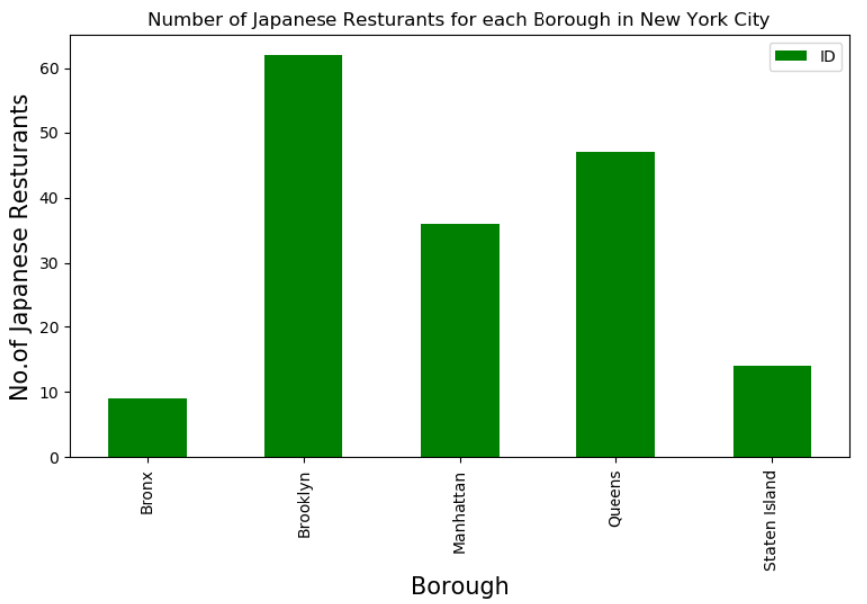
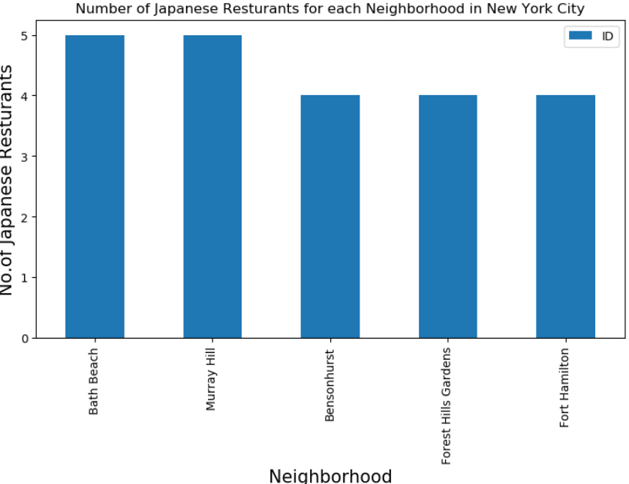
Methodology and Finding
Japanese Restaurant analysis
Chart Title
35%
Contents Here
35%
Add Text Here
Add Text Here
Add Text Here
Add Text Here
Add Text Here
Add Text Here
Add Text Here
Add Text Here
Add Text Here
Add Text Here
Add Text Here
Add Text Here

Slide 9
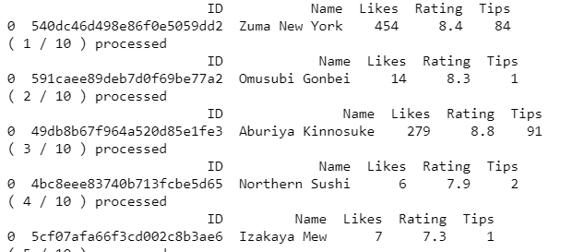
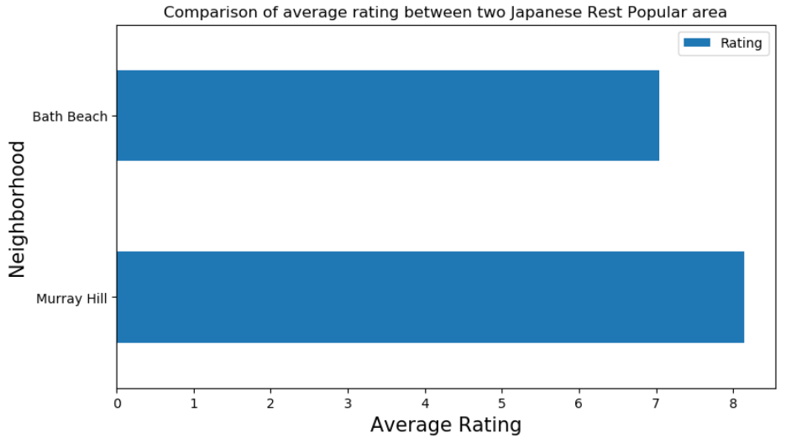
Methodology and Finding
Japanese Restaurant analysis cont..
Chart Title
35%
Contents Here
35%
Add Text Here
Add Text Here
Add Text Here
Add Text Here
Add Text Here
Add Text Here
Add Text Here
Add Text Here
Add Text Here
Add Text Here
Add Text Here
Add Text Here

Slide 10
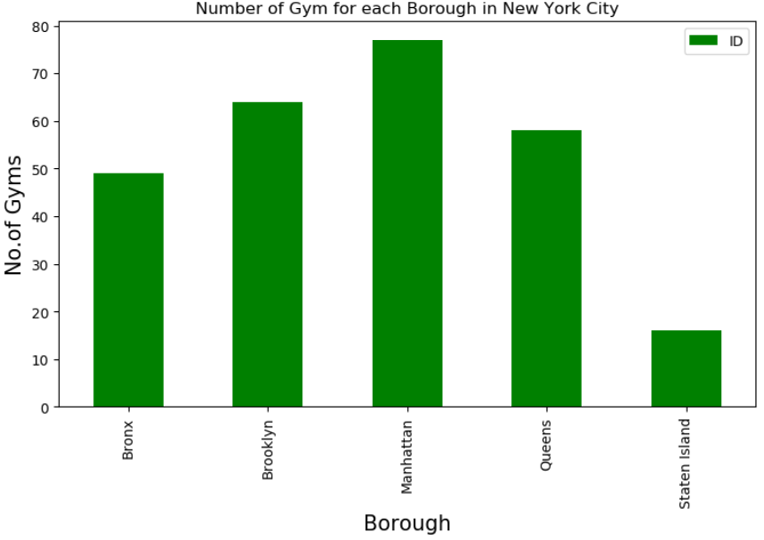
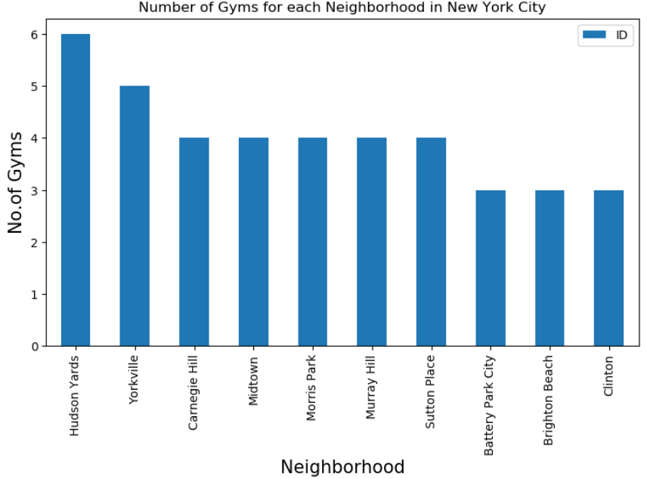
Methodology and Finding
Gym analysis
Chart Title
35%
Contents Here
35%
Add Text Here
Add Text Here
Add Text Here
Add Text Here
Add Text Here
Add Text Here
Add Text Here
Add Text Here
Add Text Here
Add Text Here
Add Text Here
Add Text Here

Slide 11
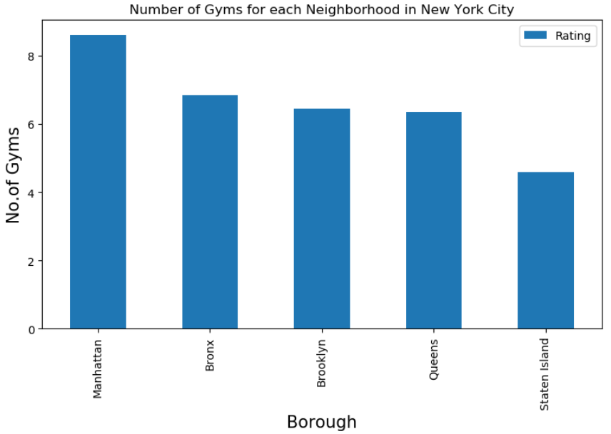
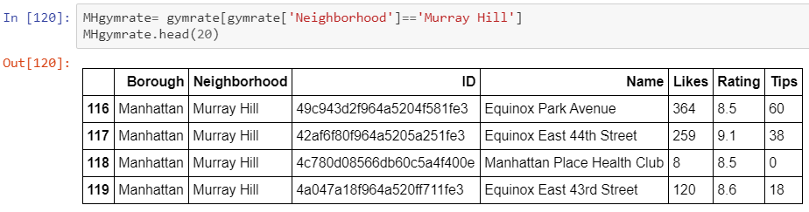
Methodology and Finding
Gym analysis cont..
Chart Title
35%
Contents Here
35%
Add Text Here
Add Text Here
Add Text Here
Add Text Here
Add Text Here
Add Text Here
Add Text Here
Add Text Here
Add Text Here
Add Text Here
Add Text Here
Add Text Here

Slide 12
Result Section
The Winner is Murray Hill !!!!
Key Reasons:
Has numbers of Japanese with great rating
Has numbers of Gym with great rating
Located in a relatively safe Borough
Close to work

Slide 13
THANK YOU

